Slide 1
Fitness Center Solution

Slide 2
Solution Overview
The Aware Fitness Center management system reports information to both residents and management using our self-installable wireless electronic sensor solution.
​

Slide 3
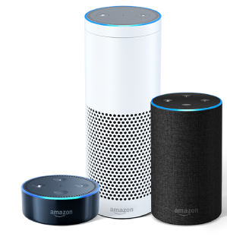
Solution Benefits
FOR MANAGEMENT
FOR RESIDENTS
Monitor the activity, usage, and equipment availability in real time
Know when to rotate machines to ensure even wear and know which type of machines you need more of and which ones should be retired
Check equipment sensor status via the Aware Admin Analytics page and get alerts of low batteries or disconnected sensors
Monitor monthly trends, and learn things such as: the most popular equipment, the busiest hours and days of week, and the usage hours per machine or machine category
Check if the equipment you want to use is available via the BuildingLink Resident mobile app
Use Amazon Echo voice commands for realtime updates of your fitness center availability and comfort factors (temperature and humidity).

Slide 4
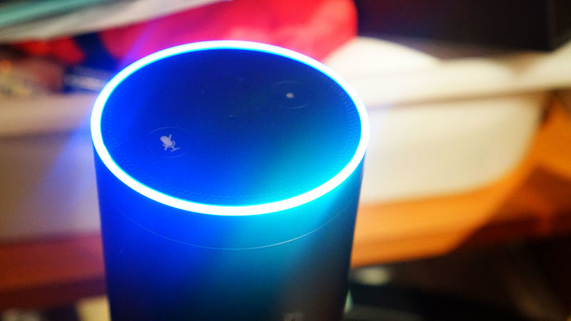
Alexa Skill for Aware for Fitness Center
Some of the things you can ask Alexa
Ask BuildingLink what’s happening in the fitness center
Tell me about the fitness center
Tell me what machines are available / Tell me if there is a treadmill available

Slide 5
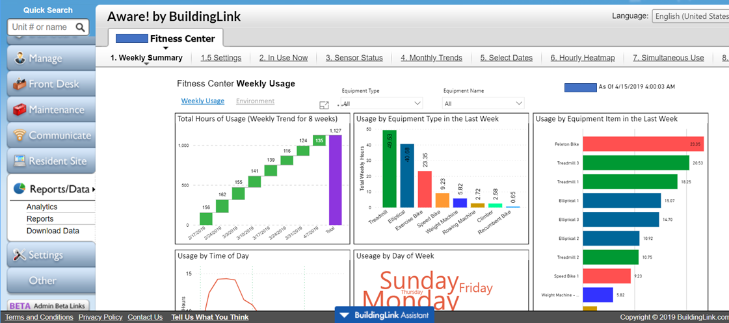
Reports and Data – Hosted within the familiar BuildingLink Interface

Slide 6
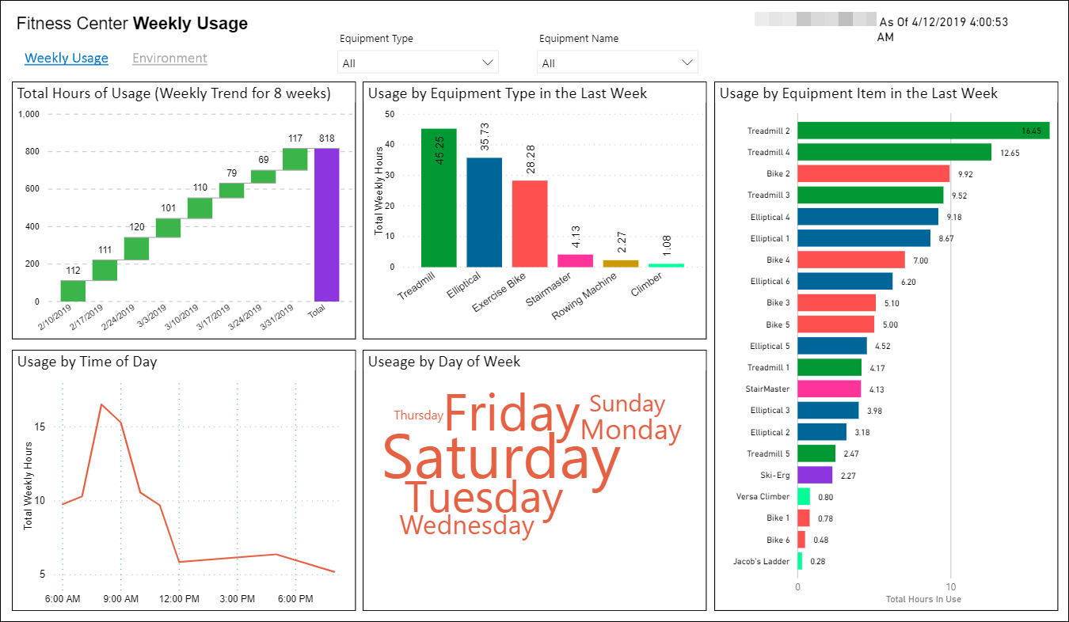
Weekly Usage Summary Report

Slide 7
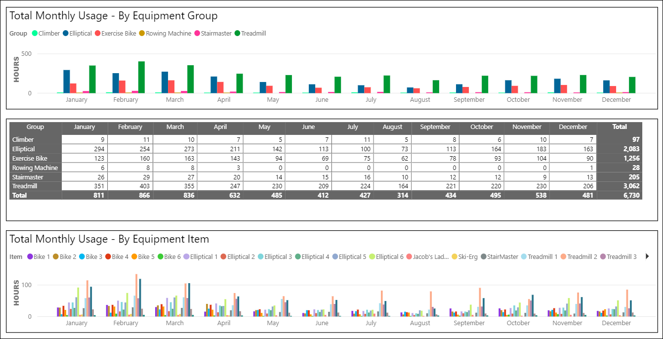
Monthly Trend Report

Slide 8
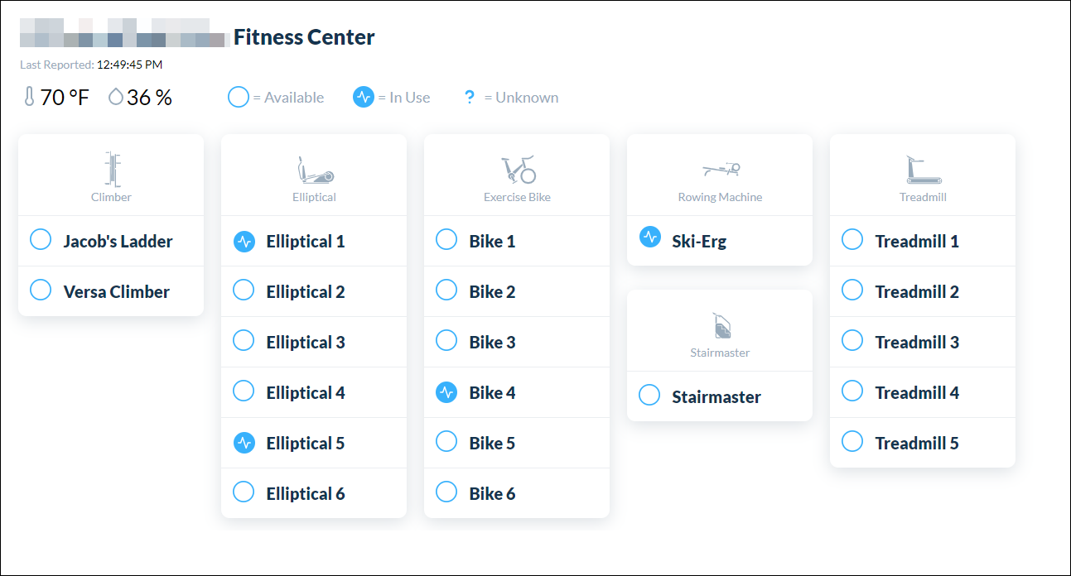
Equipment In-Use Report
Current Status for managers and residents

Slide 9
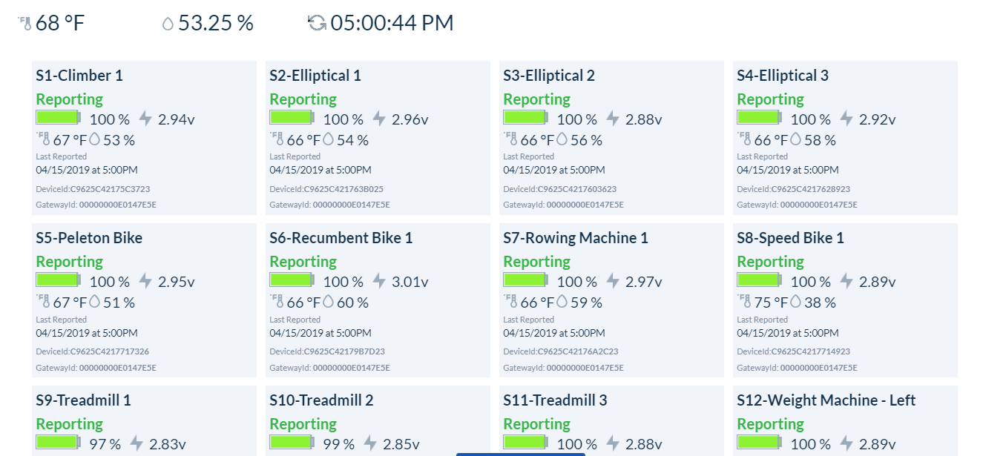
Sensor Status Overview

Slide 10
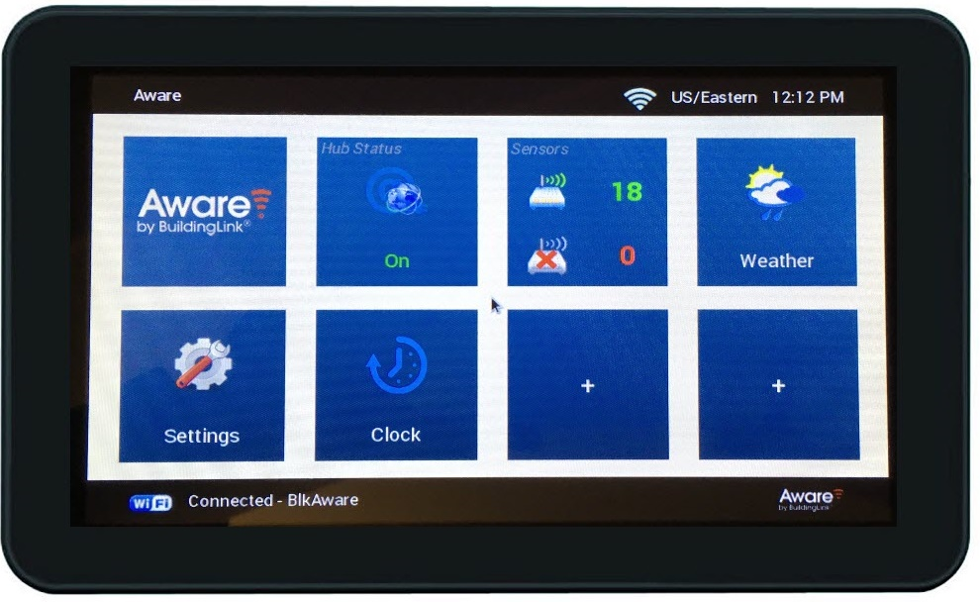
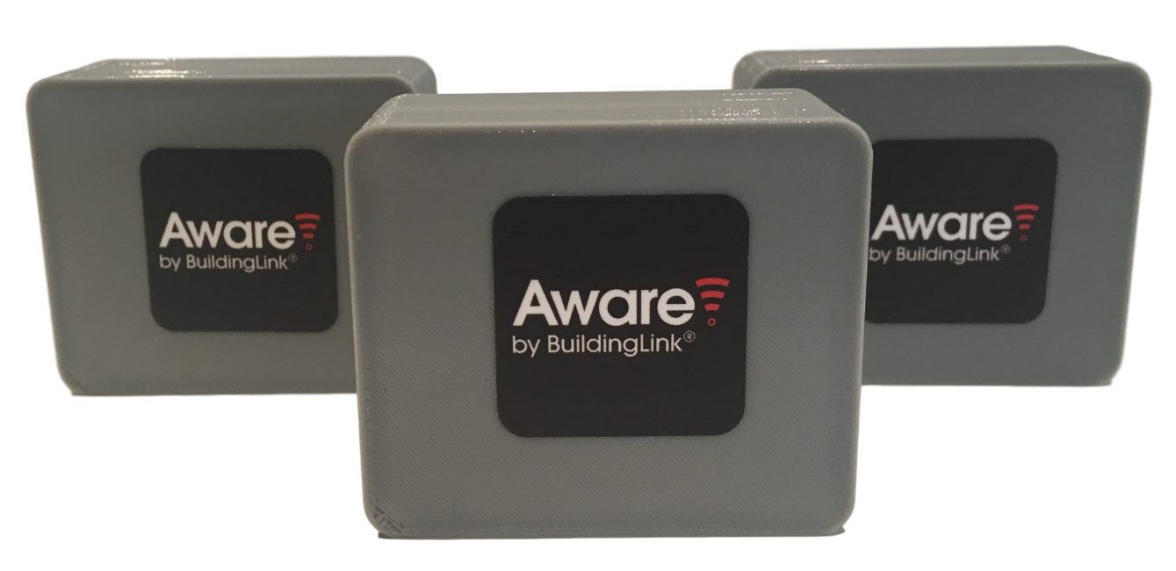
Hardware
Hub - Creates private wireless network and manages
sensor connectivity
Sensors – Attach one sensor to each fitness equipment item (electronic or mechanical) to report usage, temperature, and humidity
2 1/8 Inches
7 3/4 Inches
1 3/4 Inches
4 1/2 Inches

Slide 11
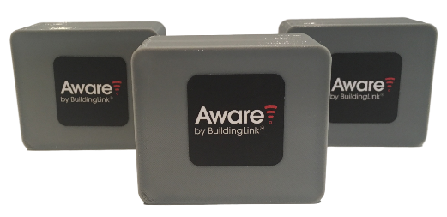
Pricing
Hardware
Subscription Costs
Hub | $250
Hub | $50 / month
One hub required for each fitness center
Sensors | $70 / ea
Sensors | $5 / month
One sensor for each piece of equipment to be monitored
Minimum subscription fee of $100 / month including hub fees
All prices in USD and Subject to Change

Slide 12
Simple Installation
Prep and Ordering
Take inventory of equipment to be monitored
Order sensors and hub
Onsite Self-Setup
Connect Hub to building internet (hard wired or WiFi)
Place hub into pairing mode and shake each sensor to pair
Affix sensors to equipment
Setup complete! Watch your data start flowing on your sensor dashboard within BuildingLink!
Launch & Reporting
Send announcement to residents that new functionality is enabled
Usage reports are sent to facility management every Monday morning

Slide 13
Testimonials
“I always check the app before I come down to the fitness center”
Resident, One Sixty Madison
“This is pretty cool, I love the temp and humidity tracking, This will also be huge for our preventative maintenance on the machines too and help in moving around items that are getting too much mileage”
Community Manager, Greystar Building

Slide 14
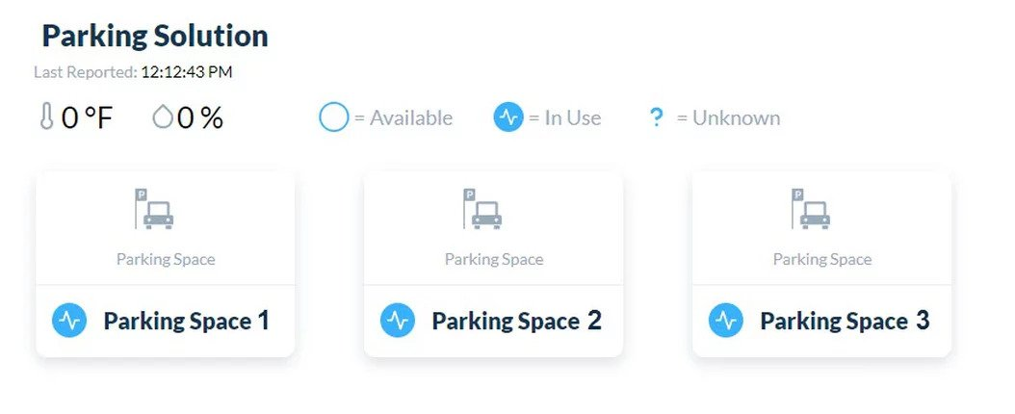
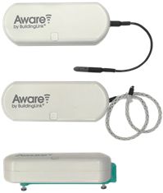
Other Aware Solutions
Parking Management
Manage tenant, guest, contractor, delivery parking
Leak Detection
Identify and detect leaks using water contact sensors, humidity probes, and rope water detectors
Physical Plant
Monitor performance of building machinery and equipment to detect problems and reduce downtime
Other Solutions Under Development:
Elevator Sensors
Toilet Flush Monitoring
Machine Vision
Occupancy Monitoring
People Counting
Pest Control
Door left ajar alarm
And other building automation /smart building solutions
HVAC Compressors
Condensing Equipment
Circulating Pumps
Booster Pumps
Boilers
Elevator Mechanical Rooms
Water Towers
Cooling Towers
Exhaust Fans
Rooftop Drains
Cellular and cable Equipment
Internet or other satellite dish equipment
Safety and Emergency Egress Doors and Barriers
Water Shut Off Valve
Remotely shut off water valves when a leak is detected or for maintenance

Slide 15
Thanks!

